Slide 1



Recommendation Based
Digital Library System
24-1-D-20
Submitters: Yuval Zohar Amit Perets
Supervisor: Dr Naomi Unkelos Shpigel
-1-

Slide 2

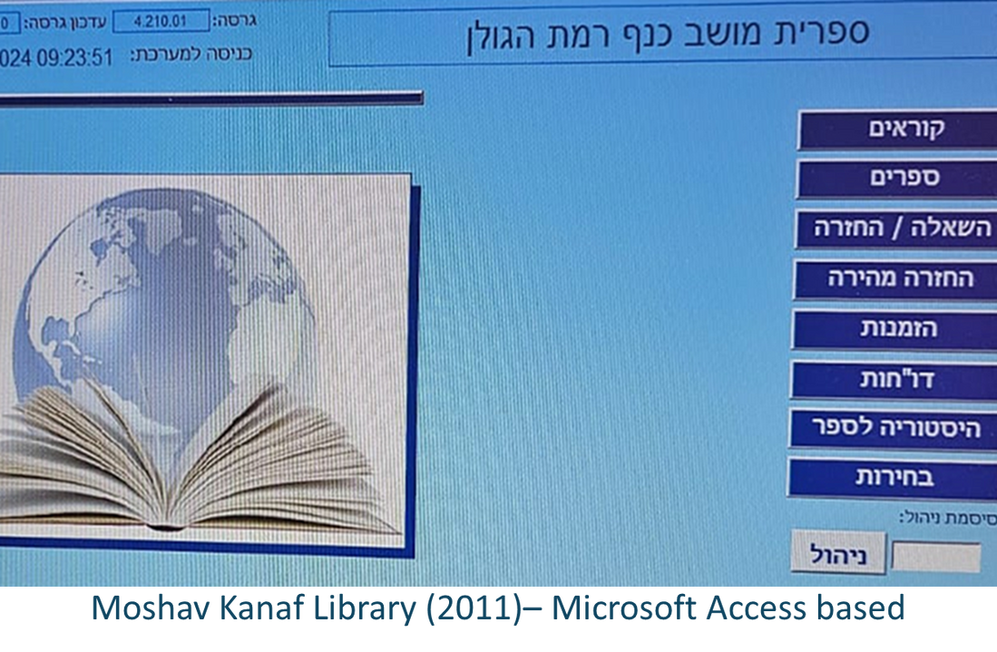
Nowadays
Limited budgets
Outdated technologies
Poor user interface
Lack of personalized recommendations
-2-

Slide 3

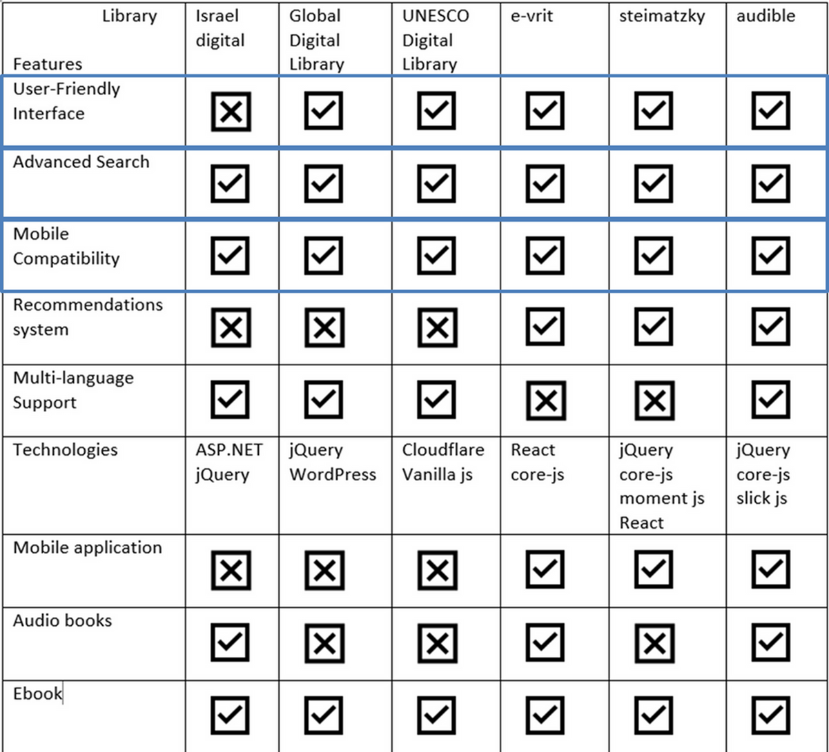

Current Library Websites
Comparison between 6 digital library systems across a variety of features and elements within them
-3-

Slide 4






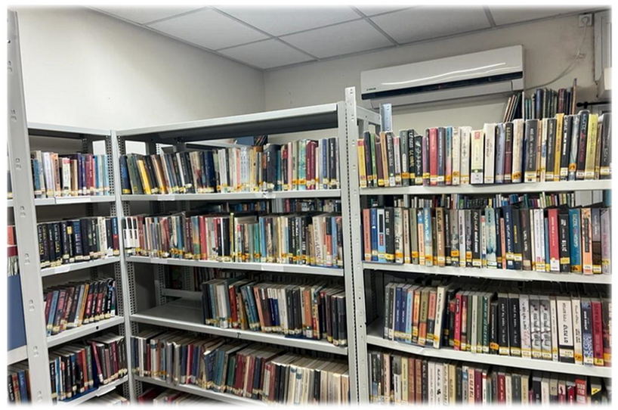

Survey for readers communities & potential readers
Requirements gathering
Interview with the library staff of Moshav Kanaf:
Shahar – Library manager
Dafi - Librarian
Reviewed the current system and its limitations
Survey for readers communities & potential readers
Gathered requirements for the intended system
Received guidelines to support the development process
-4-

Slide 5
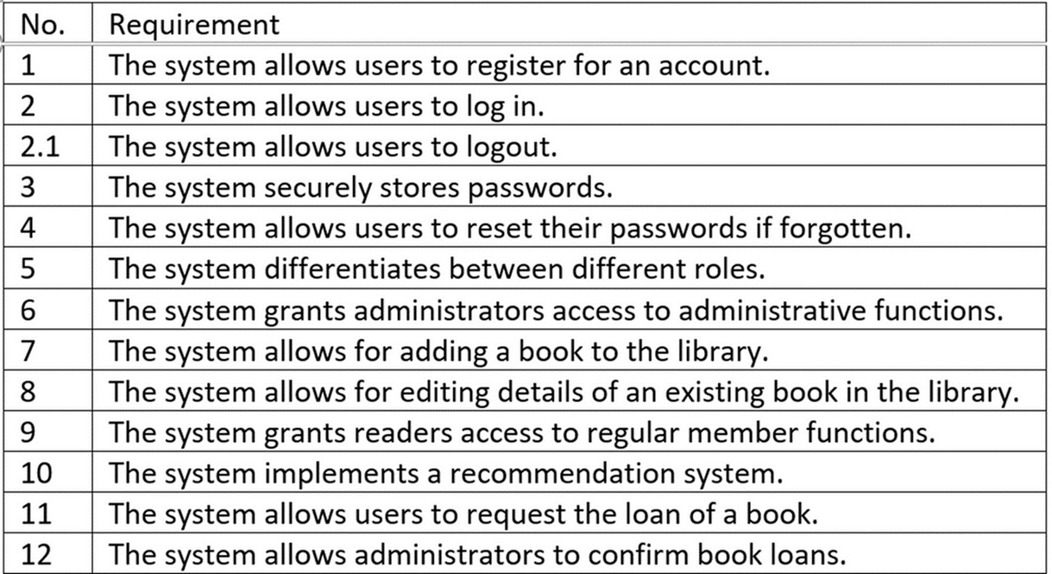
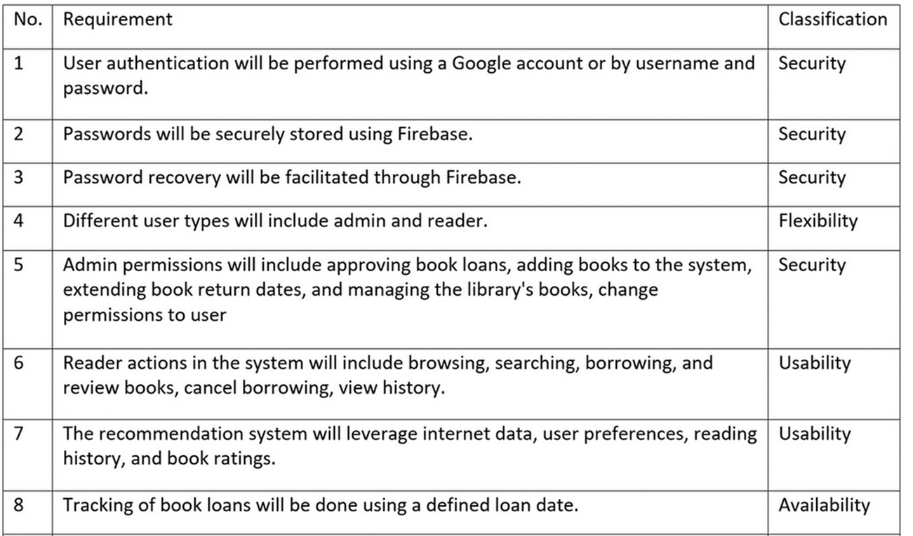

Requirements drawn from the interviews
Functional requirements
Non - functional requirements
-5-

Slide 6

Our Solution
Modern Technologies
Implemenation of a user-friendly interface
Adaptions for those lacking technological knowledge
Integration of recommendation system
Free accessiblity to both small and large libraries
-6-

Slide 7
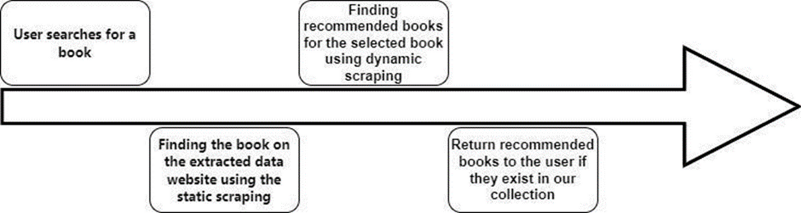
Algorithm - Web scraping
Why not to use AI directly ?
Data !!
-7-

Slide 8
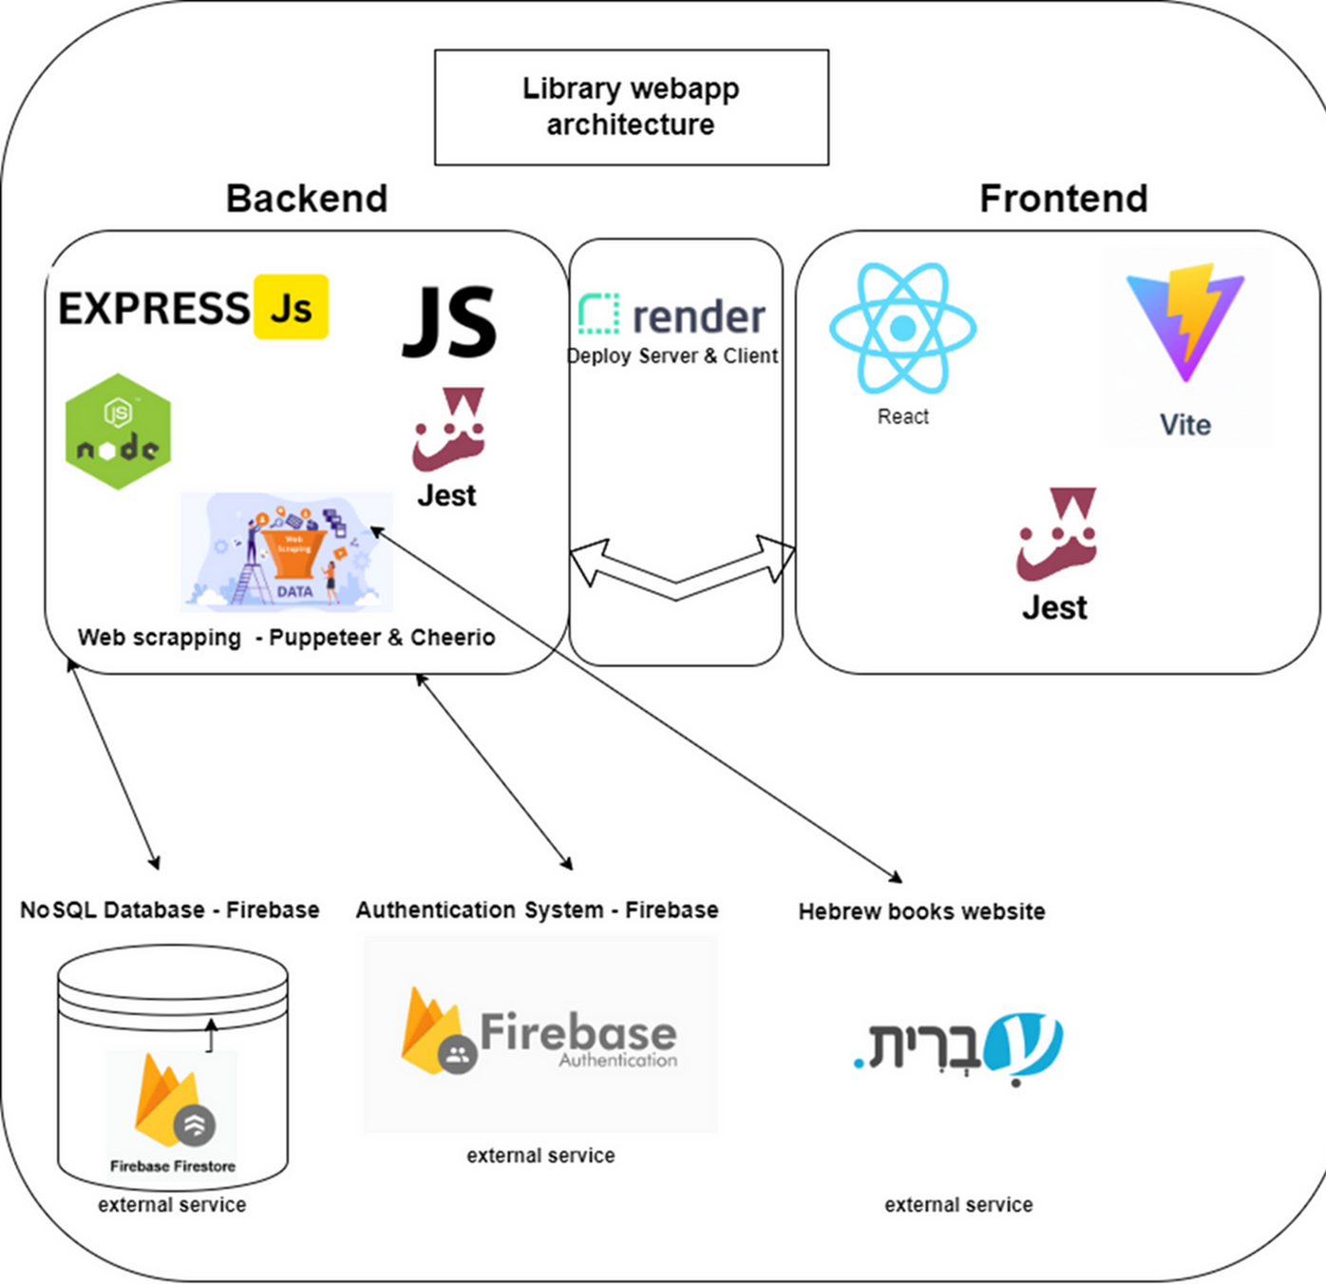
System architecture
-8-

Slide 9

Challenges
Tracking books copies
Lack of large Hebrew book API or dataset
Web-scraping
Gather information from outdated and disorganized files containing data about the library
Firebase’s free plan limitations
-9-

Slide 10

Client Meetings Timeline
February – Conducted interviews with the library staff and gathered detailed requirements to understand their needs and expectations for the website.
August – Delivered the first version of the website to the library team for initial feedback, enabling us to make iterative improvements.
September – Delivered an advanced version of the website, incorporating feedback and additional features for further testing and review by the library team.
-10-

Slide 11

Library Staff Feedback
Our clients were impressed with the website, and requested a few additional features to enhance the user experience. Below are the key points:
Admin access: Enable admin users to view user history and modify the loan period.
Return requests: Add expected return dates to borrowed books.
New books: Display newly added books prominently on the main screen.
Book color indicator: Change book color based on the borowing duration.
-11-

Slide 12



Metrics
 | 30% increase in digital library usage, 85% user satisfaction
 | 99.5% availability
 | 70% user adoption within 3 months
 | 100% staff adoption within 1 months
 | 100% of client feedback from meetings will be addressed and completed
 | 100% of pages will be fully responsive and functional on mobile, tablet, and desktop devices.
-12-

Slide 13
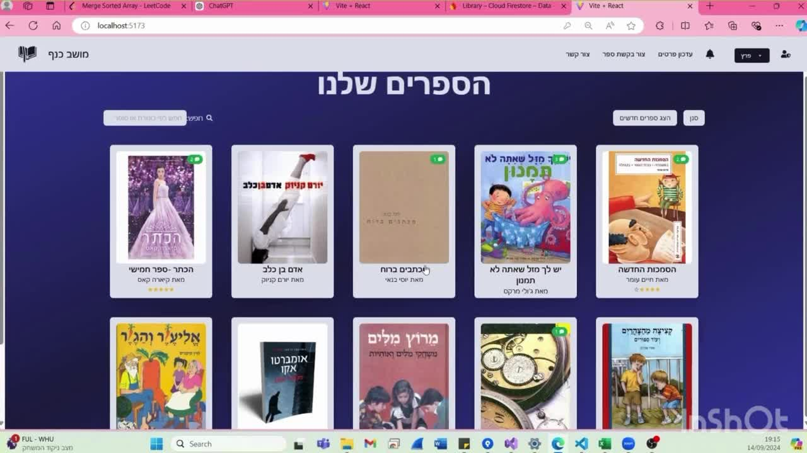
Demo video

Slide 14
SUS questionnaire
18 responses
I need to learn many things before I can use this system.
I felt very confident when using the system.
I found the system to be very cumbersome to use.
In my opinion, most people will be able to learn how to use this system easily.
SUS Final score: 97.5
-14-

Slide 15

Additional Questions
Results Overview
User-Friendly: Intuitive and easy to use.
Great Design: Simple, clean, and professional.
Improvements: Speed up recommendations and adjust color scheme.
Liked Features: Google login, book history, availability notifications.
What elements did you like in the system?
What elements do you think should be improved in the system?
Additional comments regarding the system
-15-

Slide 16

What’s Next ?
Recommendations based on additional data
Add features based on the results of future user questionnaires
Recommendations based on AI models – Required Data
-16-

Slide 17

Thank You !
Questions ?
-17-

